Slide 1


FINANCIAL ANALYSIS
OF TOP 500 COMPANIES

Slide 2


INTRODUCTION
This report's objective is to evaluate the top 500 corporations financial performance. The examination centers on market capitalization and quarterly sales, offering valuable perspectives on their financial well-being and competitive standing. The market capitalization and quarterly sales numbers of these firms are included in the dataset that was utilized for this investigation.
29/5/2024
FINANCIAL ANALYSIS

Slide 3
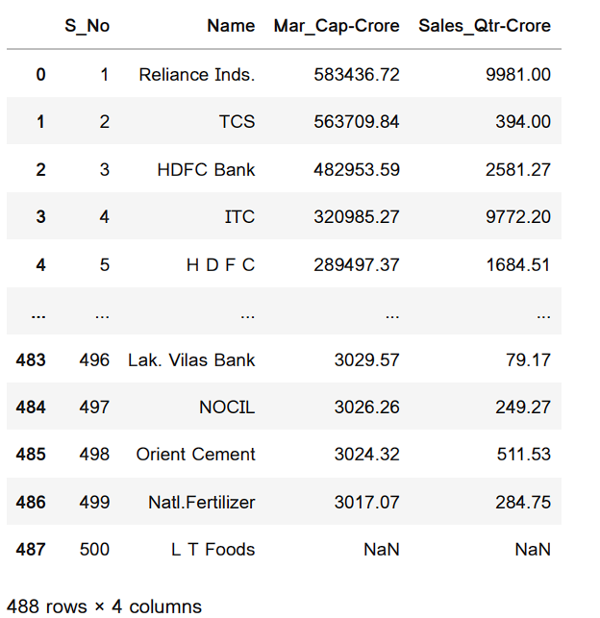
DETAILS OF DATA
S_NO: SERIAL NUMBER
Name: Company Name
Mar_Cap-Crore: Market Capitalization in Crores
Sales_Qtr-Crore: Quarterly Sales in Crores
29/5/2024
FINANCIAL ANALYSIS

Slide 4
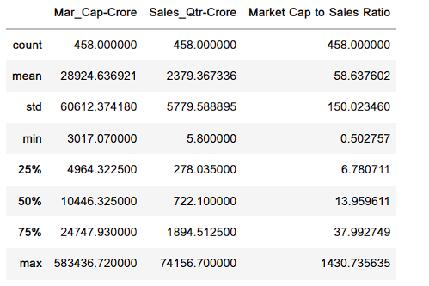
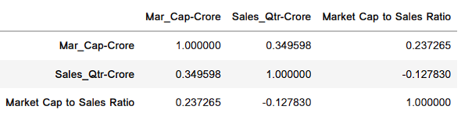
FINANCIAL METRICS ANALYSIS
DESCRIPTIVE STATISTICS
CORRELATION ANALYSIS
Summary statistics for market cap, quarterly sales, and market cap to sales ratio.
Correlation matrix showing relationships between metrics.
29/5/2024
FINANCIAL ANALYSIS

Slide 5
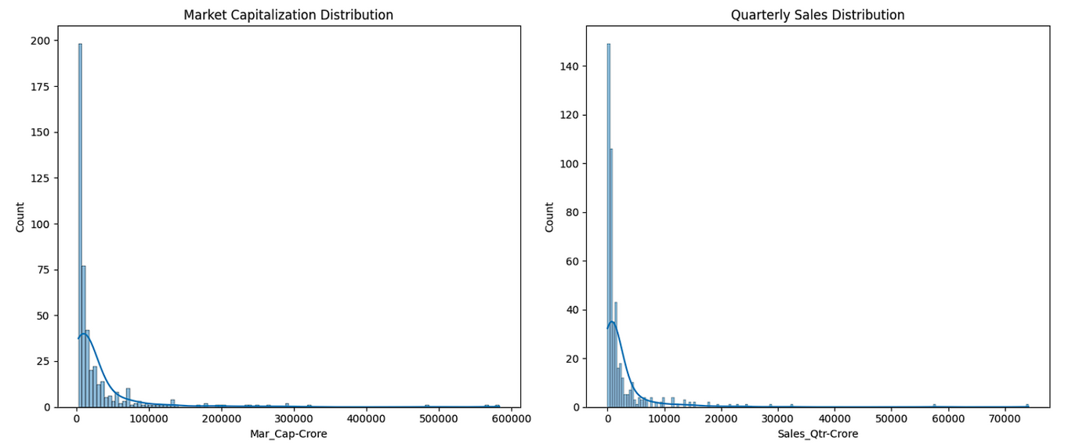
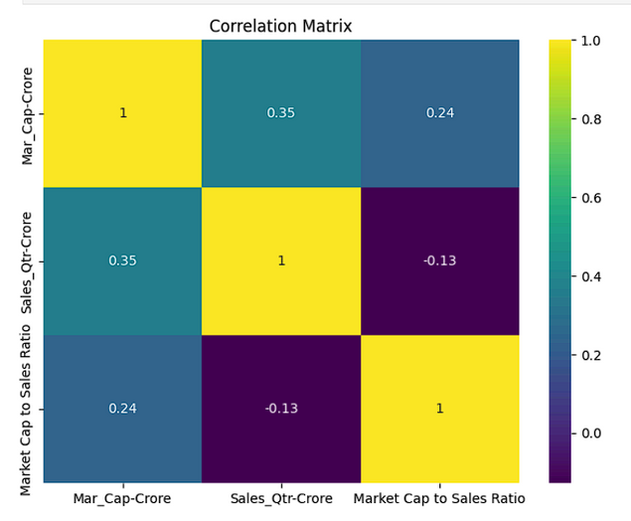
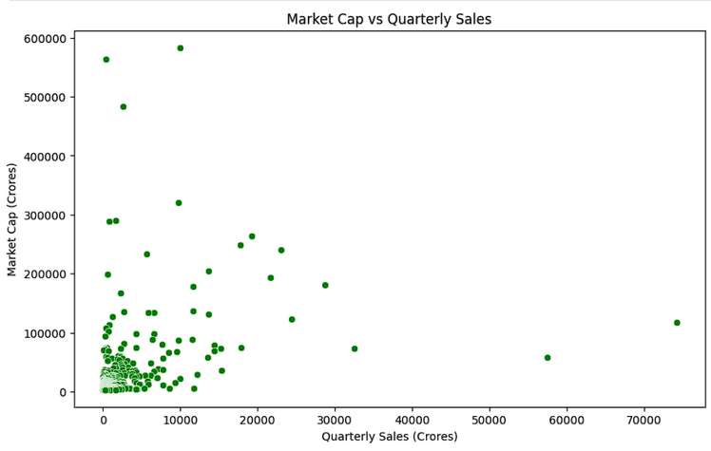
VISUALIZATION AND INSIGHTS

Slide 6
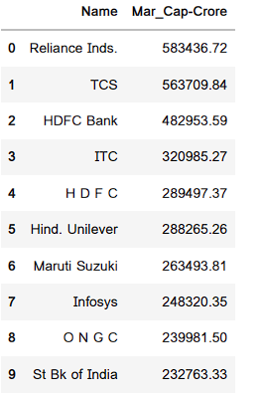
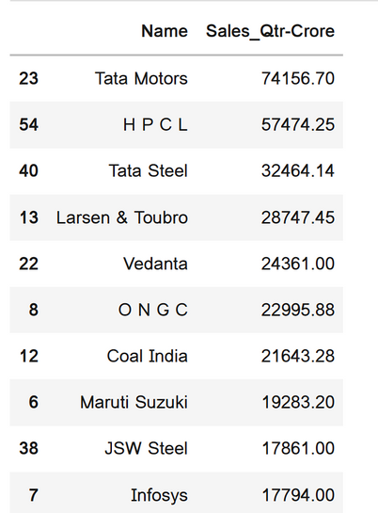
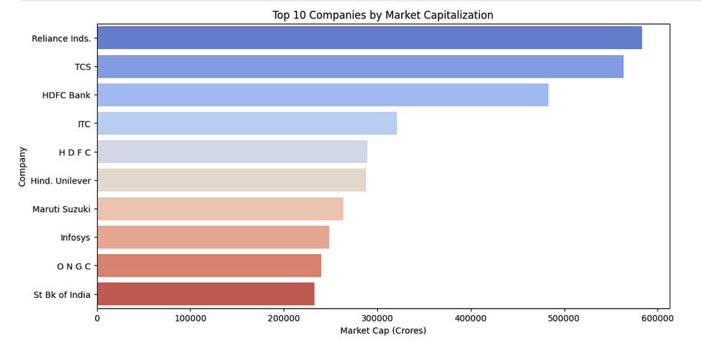
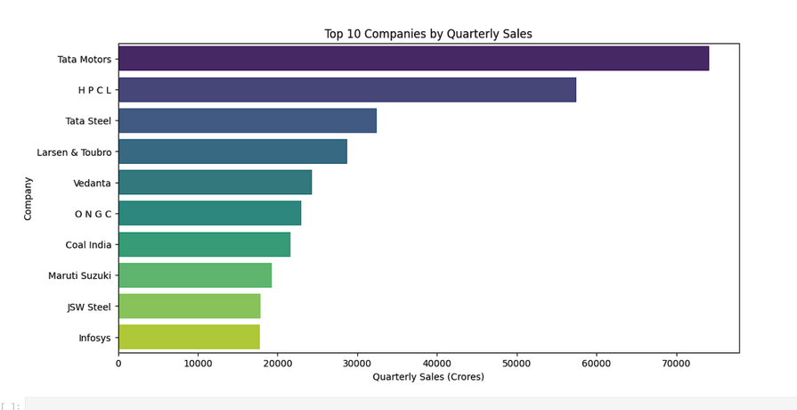
TOP PERFORMERS
TOP 10 COMPANIES BY MARKET CAPITALIZATION
TOP 10 COMPANIES BY QUARTERLY SALES

Slide 7


THANK YOU

